Slide 1
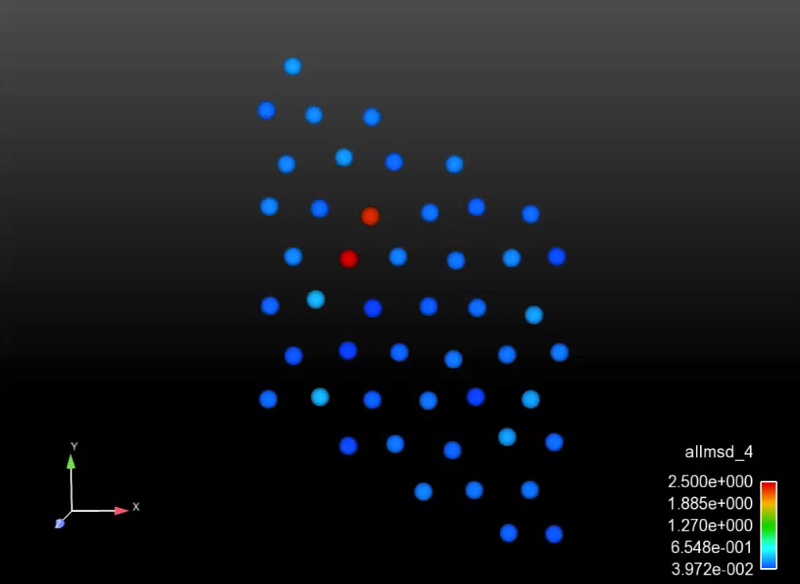

Unexpected (sort of) Anisotropy of Cation & Anion Diffusion in Cr₂O₃
Penghui Cao¹, Daniel Wells², Dennis Hussey², Michael Short¹
¹ Department of Nuclear Science and Engineering, MIT, USA
² Electric Power Research Institute (EPRI), Palo Alto, CA & Charlotte, NC, USA
TMS-2016, Nashville, TN
February 15, 2016

Slide 2
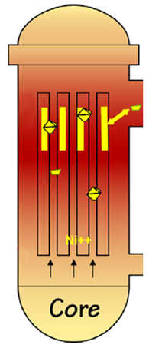
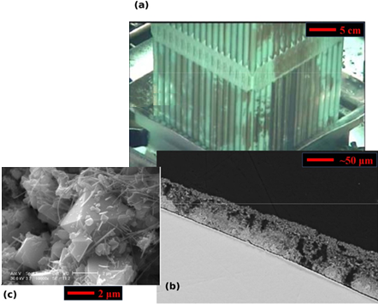
Multiscale Modeling of the CRUD Source Term
Chalk River Unidentified Deposits: Corrosion deposits on fuel rods
Corrosion products deposit as CRUD on fuel rods
To hot leg
CRUD constituent phases
What about the CRUD source term?
CRUD cross section showing typical structure
To cold leg
Short, M. P.,et al. MRS-B 39(1):71-77 (2014)
CASL phase I scope

Slide 3
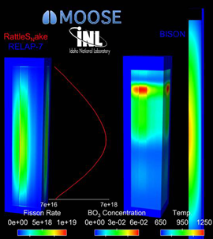
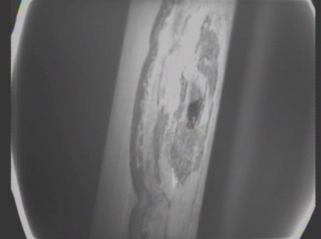

What Is CRUD? Why Does It Matter?
Chalk River Unidentified Deposits: Causes operational problems like:
Axial downward power shift
CRUD-induced localized corrosion
Core Height
CRUD induced power shift
“Leaker” fuel failures
BO₃ Concentration
Power
Image: D. Gaston et al. Ann. Nucl. Ener., doi: 10.1016/j.anucene.2014.09.060 (2014)
Image: D. Wells. EPRI Summer P-TAC Meeting (2013)

Slide 4

First: An Overall System View
Where does CRUD come/go in a PWR primary loop?
Hot Leg: 304SS, ~330C
Steam Generator: Alloy 600/690, 330C (Inlet) to 290C (Outlet)
Core: Contains fuel rods with sub-cooled boiling, removing particulates
Cold Leg: 304SS, ~290C

Slide 5
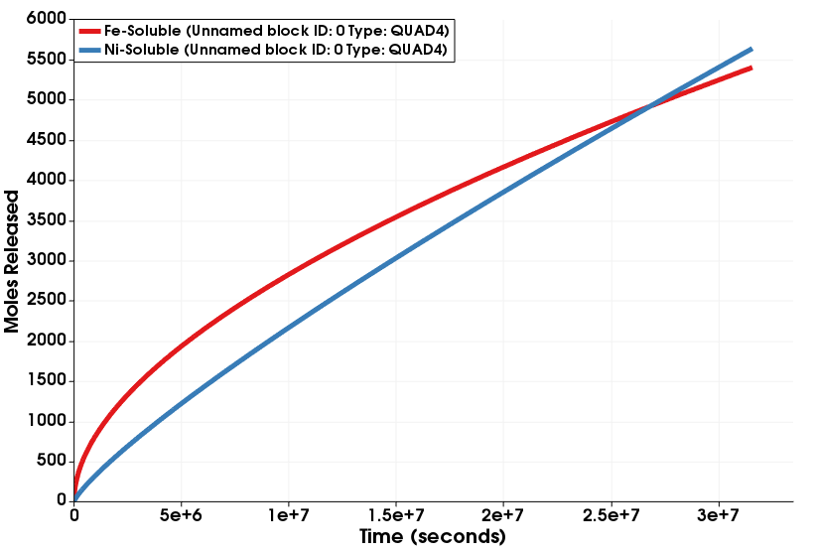
Engineering Scale: What Is Missing?
Ultimate goal: Predict the Ni & Fe metal release terms
Acts as source term for CRUD deposition codes (MAMBA¹, BOA²)
? ? ?
¹ Developed by CASL
² Developed by EPRI

Slide 6

Choosing What (NOT) To Model
Low Ni,Fe High Ni,Fe
in coolant in coolant
Flow, Erosion
600 | 690 | 304
600 | 690 | 304
NiFe₂O₄
(Ni,Fe)(Cr,Fe)₂O₄
(Ni,Fe)Cr₂O₄
Cr₂O₃
Metal with (Cr,Ni) depletion zone
Base alloy
O
Fe
Cr
[1] [1] [1] [1] [2]
Diffusion/Transport
Missing diffusivity data
[1] T. Devine, ibid
[2] S Cisse et al. Corr. Sci., 56:209-216 (2012).

Slide 7
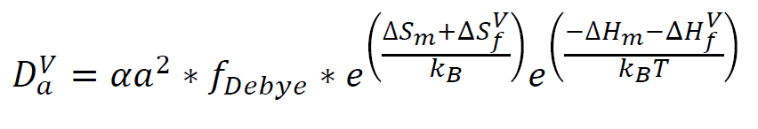
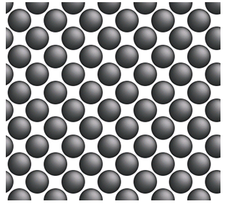
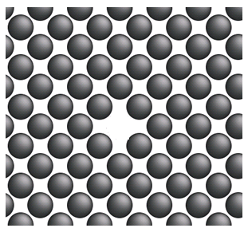
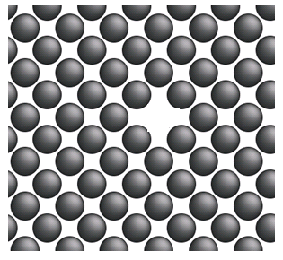
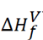
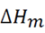
Computing Unknown Diffusivities

Slide 8
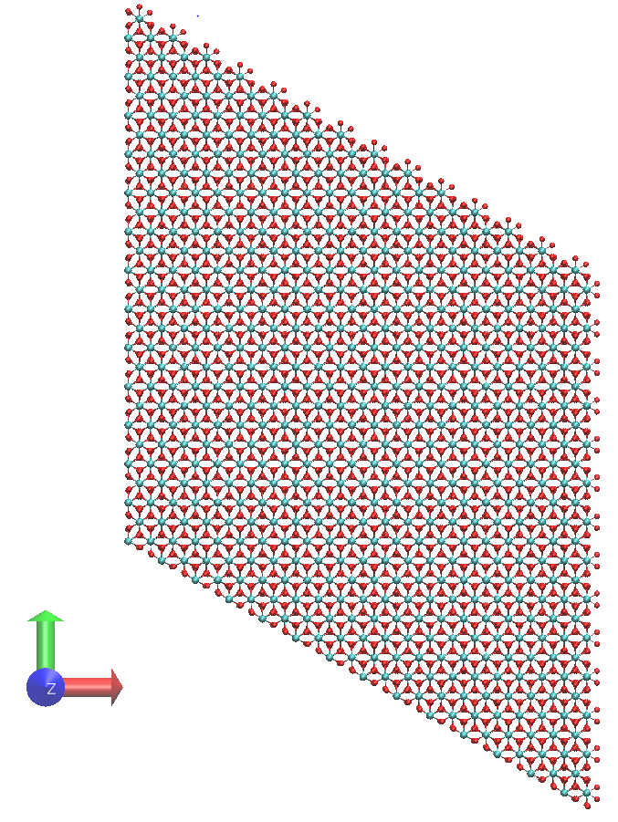
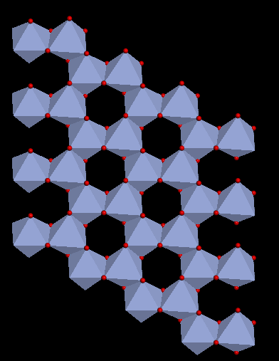
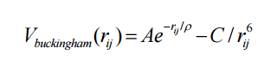
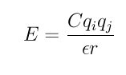
Computing Unknown Diffusivities: Cr₂O₃
Buckingham potential: Compensates charge loss due to ionic defects [1-2]
Model: 18x18x6 hexagonal unit cell with periodic boundary conditions, 58,320 atoms
[1] R. Grimes. Phil. Mag. A, 72(3):651-668 (1995).
[2] Minervini et al., J. Mater. Chem., 10:2349-2354 (2000).

Slide 9
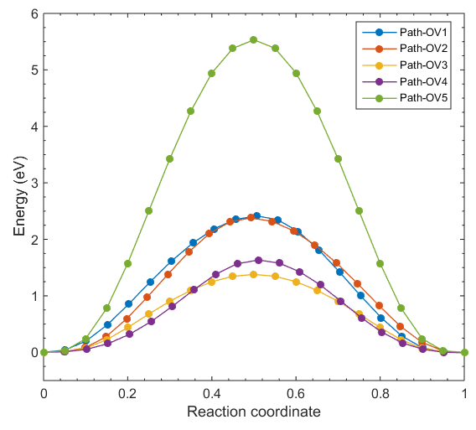
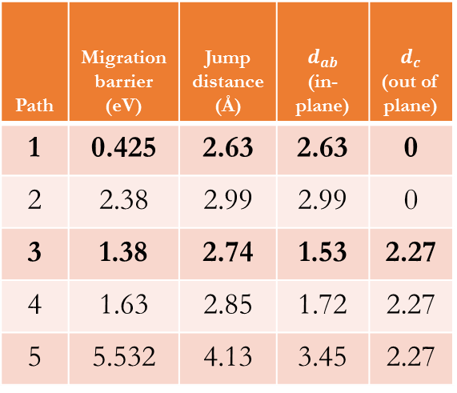
Computing Unknown Diffusivities: O in Cr₂O₃
Path 1
Path 2
Path 3
Path 4
Path 5
Path | Migration barrier (eV) | Jump distance (Å) | $$d_{ab}$$ (in-plane) | $d_{c}$ (out of plane)
1 | 0.425 | 2.63 | 2.63 | 0
2 | 2.38 | 2.99 | 2.99 | 0
3 | 1.38 | 2.74 | 1.53 | 2.27
4 | 1.63 | 2.85 | 1.72 | 2.27
5 | 5.532 | 4.13 | 3.45 | 2.27
In-plane diffusion
Out-of-plane

Slide 10
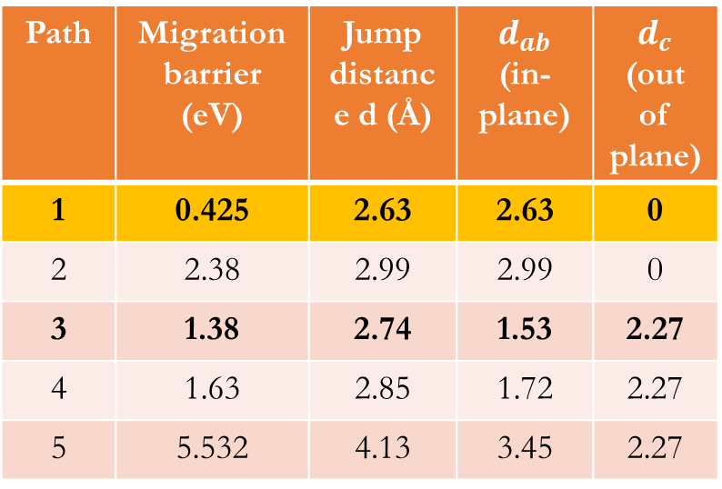
Watching Oxygen Diffusion Mechanisms
Path | Migration barrier (eV) | Jump distance d (Å) | $$d_{ab}$$ (in-plane) | $d_{c}$ (out of plane)
1 | 0.425 | 2.63 | 2.63 | 0
2 | 2.38 | 2.99 | 2.99 | 0
3 | 1.38 | 2.74 | 1.53 | 2.27
4 | 1.63 | 2.85 | 1.72 | 2.27
5 | 5.532 | 4.13 | 3.45 | 2.27
Atoms colored by displacement from original sites
What this means:
Oxygen diffuses mostly in-plane…

Slide 11
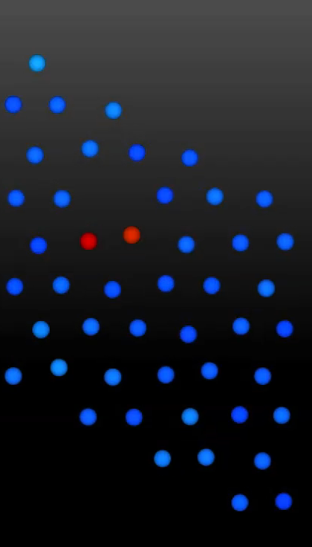
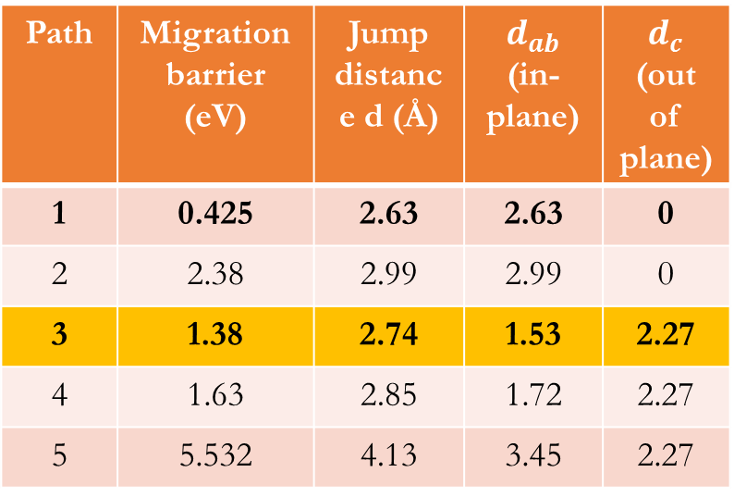
Watching Oxygen Diffusion Mechanisms
Path | Migration barrier (eV) | Jump distance d (Å) | $$d_{ab}$$ (in-plane) | $d_{c}$ (out of plane)
1 | 0.425 | 2.63 | 2.63 | 0
2 | 2.38 | 2.99 | 2.99 | 0
3 | 1.38 | 2.74 | 1.53 | 2.27
4 | 1.63 | 2.85 | 1.72 | 2.27
5 | 5.532 | 4.13 | 3.45 | 2.27
Atoms colored by displacement from original sites
What this means:
Oxygen diffuses mostly in-plane… but out-of-plane jumps do happen.

Slide 12
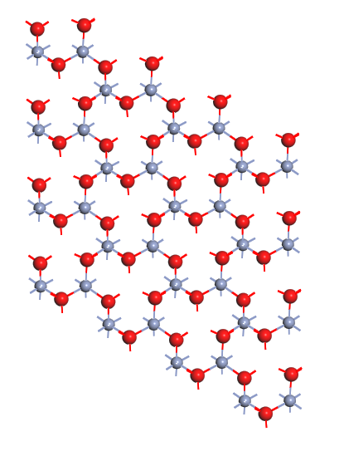
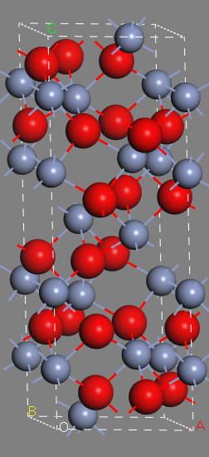
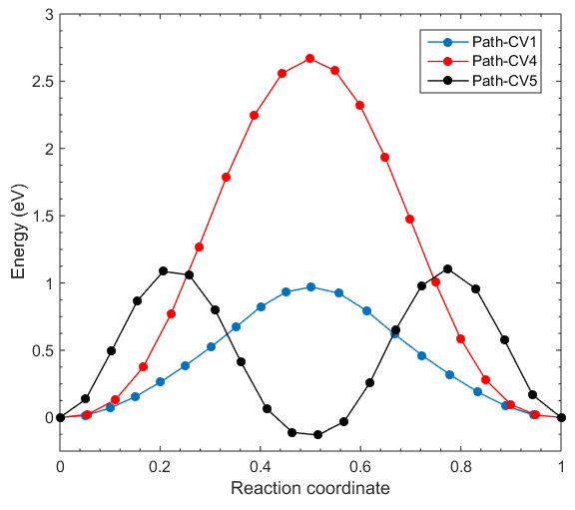
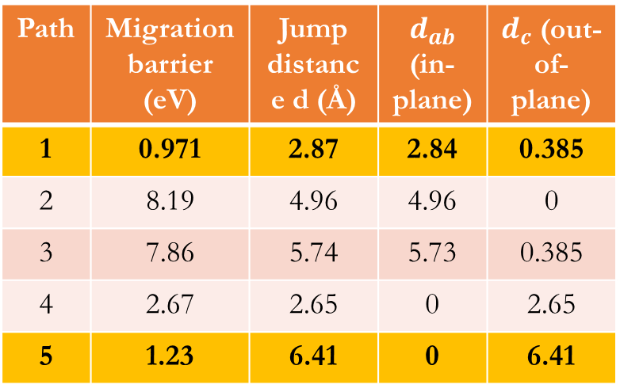
Unknown Diffusivities: Cr in Cr₂O₃
Path | Migration barrier (eV) | Jump distance d (Å) | $$d_{ab}$$ (in-plane) | $d_{c}$ (out-of-plane)
1 | 0.971 | 2.87 | 2.84 | 0.385
2 | 8.19 | 4.96 | 4.96 | 0
3 | 7.86 | 5.74 | 5.73 | 0.385
4 | 2.67 | 2.65 | 0 | 2.65
5 | 1.23 | 6.41 | 0 | 6.41
2
3
5
1
4

Slide 13
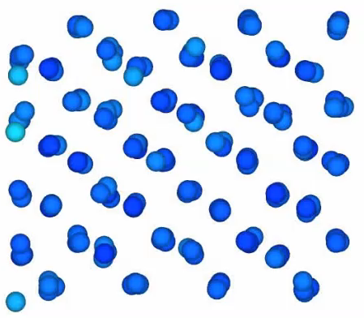
Watching Chromium Diffusion Mechanisms
2
3
5
1
4
What does this mean?
Cations migrate out-of-plane, which is very anisotropic.

Slide 14
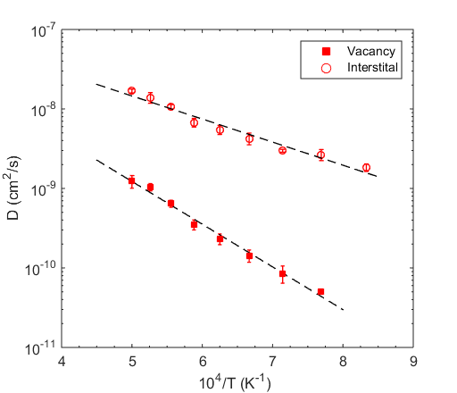
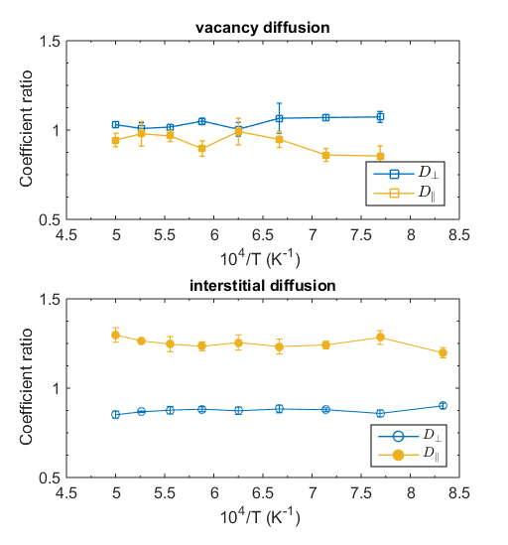
Full Cr₂O₃ Dataset for Oxygen
Mildly anisotropic (50%)

Slide 15
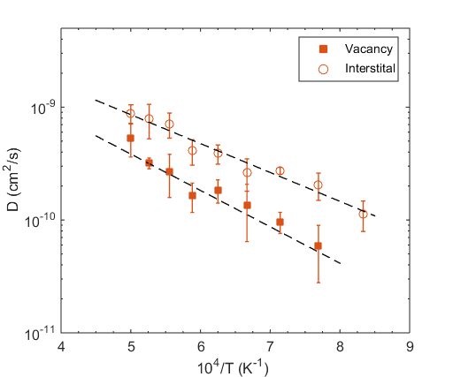
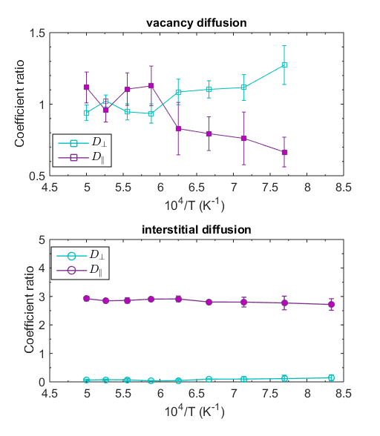
Full Cr₂O₃ Dataset for Chromium
Highly anisotropic (30x)

Slide 16
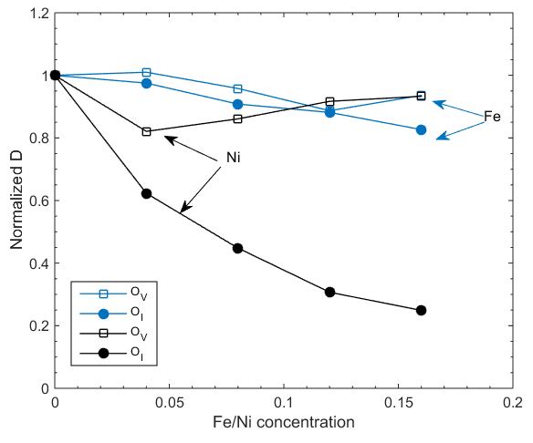

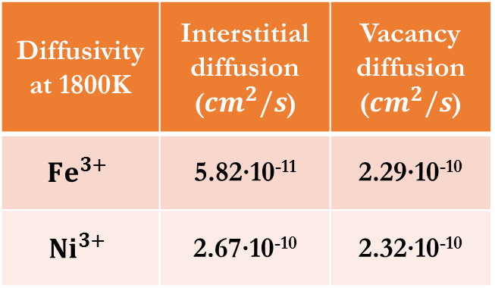
Effects of Dopant Cations
Ni slows oxygen diffusion more than Fe for both defects
At 1800K, ${({Cr}_{}^{0.33}{Fe}_{}^{0.33}{Ni}_{}^{0.33})}_{2}O_{3}$
Diffusivity at 1800K | Interstitial diffusion (${cm}^{2}/s$) | Vacancy diffusion (${cm}^{2}/s$)
$${Fe}^{3+}$$ | 5.82∙10⁻¹¹ | 2.29∙10⁻¹⁰
$${Ni}^{3+}$$ | 2.67∙10⁻¹⁰ | 2.32∙10⁻¹⁰

Slide 17

Diffusion Coefficients in Cr₂O₃
O diffusivity: $D\left(T\right)=7.5$x${10}^{−4}e^{(−4.42/k_{B}T)}$ (plus doping effects)
Cr diffusivity: $D\left(T\right)=1.97$x${10}^{−5}e^{(−4.55/k_{B}T)}$
Fe diffusivity: $D\left(T\right)=1.51$x${10}^{−6}e^{(−4.02/k_{B}T)}$
Ni diffusivity: $D\left(T\right)=1.50$x${10}^{−5}e^{(−4.28/k_{B}T)}$

Slide 18
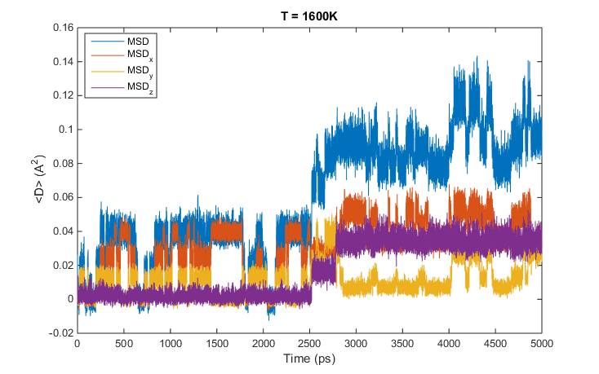
Comparison to Recent Work
Same diffusivities studied by MD in Cr₂O₃, different results
J. Vaari. “Molecular dynamics simulations of vacancy diffusion in chromium(III) oxide, hematite, magnetite and chromite.” Solid State Ionics, 270:10-15 (2015).

Slide 19


Check Calculations with Experimental Data
Check computed MD Cr₂O₃ data with tracer diffusion experiments
Our Calcs: $D_{Cr}=2.3×{10}^{−19}\frac{{cm}^{2}}{sec} at 700C$
$$D_{Cr,{Cr}_{2}O_{3}}=2.4×{10}^{−15}\frac{{cm}^{2}}{sec} at 900C$$
$$D_{Ni,{Cr}_{2}O_{3}}=2.6×{10}^{−14}\frac{{cm}^{2}}{sec} at 900C$$
$$D_{Fe,{Cr}_{2}O_{3}}=3.4×{10}^{−14}\frac{{cm}^{2}}{sec} at 900C$$
A. C. S. Sabioni et al. “Diffusion of iron in Cr2O3: polycrystals and thin films.” Mat. Sci. Eng. A, 392:254-261 (2005)
R. E. Lobing et al. “Diffusion of Cations in Chromia Layers Grown on Iron-Base Alloys.” Oxidation of Metals, 37(1-2) (1992)

Slide 20
Comparison to Other Systems
Charged defect anisotropy is quite common in other systems
Long-range, anisotropic diffusion by hand-to-hand tetrahedral in La_{1-x}Ba_{1+x}GaO_{4x/2} by DFT
In-plane O diffusion by the vacancy mechanism, with oxygen ion density in red
E. Kendricket al. Nat. Mater., 2007, 6, 871
A. Chroneos et al. J. Mater. Chem., 20:266-270 (2010)

Slide 21
Implications of This Work
Differently oriented Cr₂O₃ will:
Oxidize faster/slower
Pass impurity cations more/less quickly
Different component processing methods may impart different Cr₂O₃ oxide textures, lead to varying performance
Being observed in nuclear reactor steam generator tubes

Slide 22
Implications of This Work
May not sound important… but…
Reducing metal release in reactors by 2x could greatly alleviate corrosion deposit (CRUD) buildup on fuel rods
May guide processing treatments for steam generator tubes

